Slide 1

Social Science Research Design and Statistics, 2/e
Alfred P. Rovai, Jason D. Baker, and Michael K. Ponton
Using the Chart Editor
PowerPoint Prepared by
Alfred P. Rovai
IBM® SPSS® Screen Prints Courtesy of International Business Machines Corporation,
© International Business Machines Corporation.

Slide 2
Using the Chart Editor
The Chart Editor provides a tool one can use to customize charts.
To open the Chart Editor simply double-click on the chart. This will open the Chart Editor window containing many chart editing features (changing titles, adding reference lines, identifying points on a scatterplot, changing axes, changing bar colors, etc.).

Slide 3
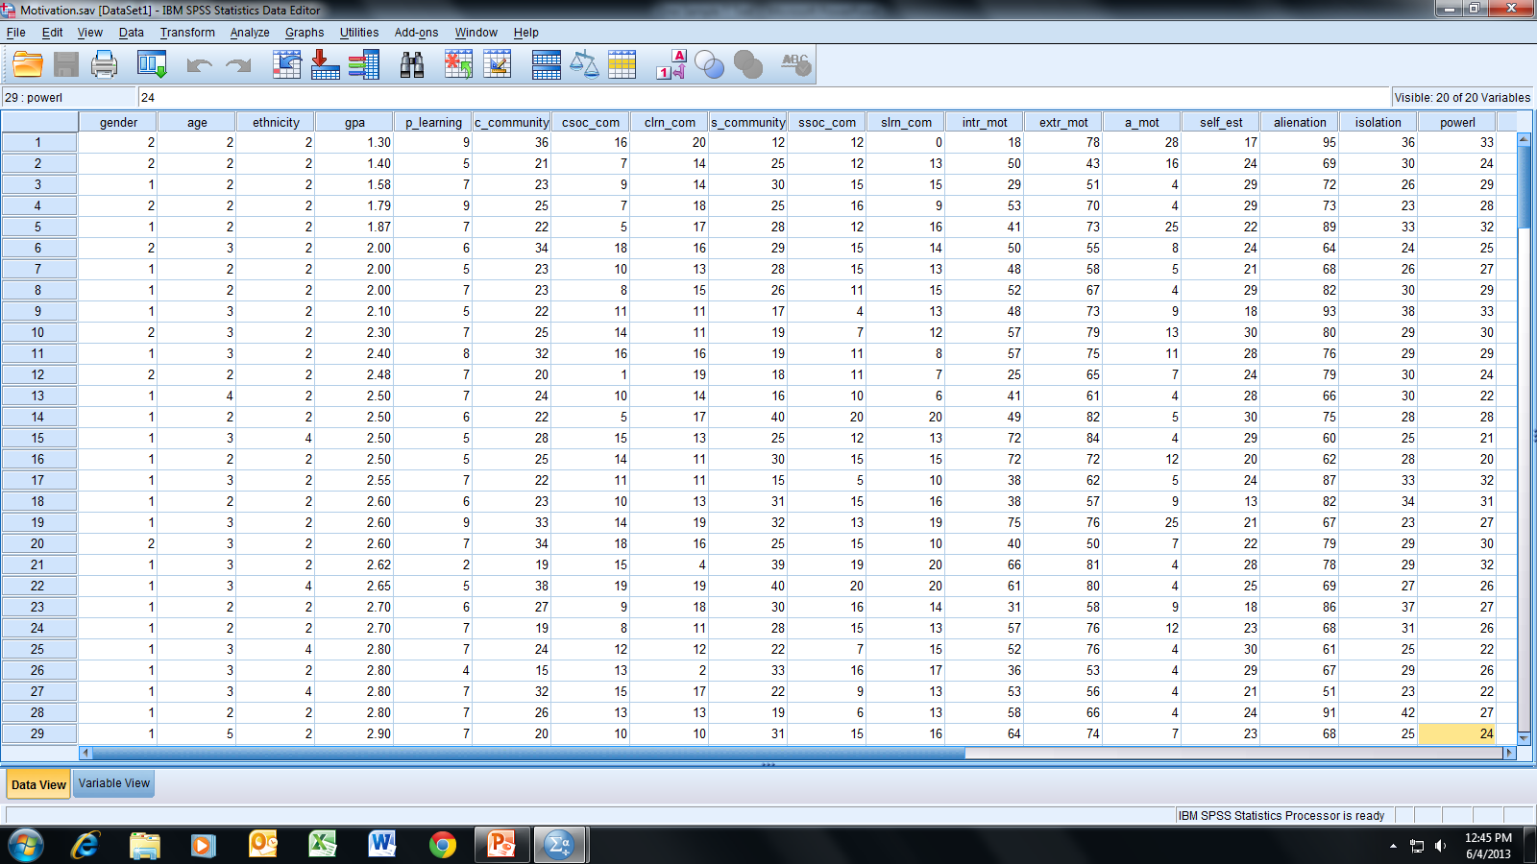
Open the dataset Motivation.sav.
File available at http://www.watertreepress.com/stats
TASK
Modify a histogram of
Alienation created by either Chart Builder or Legacy Dialogs.

Slide 4
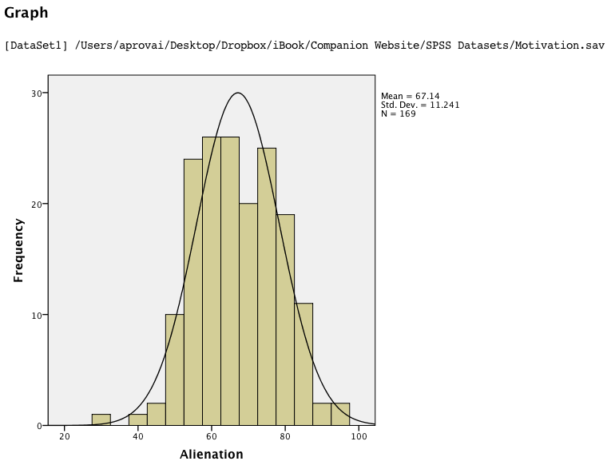
SPSS Output
To modify this chart, double click it to launch the
Chart Editor.

Slide 5
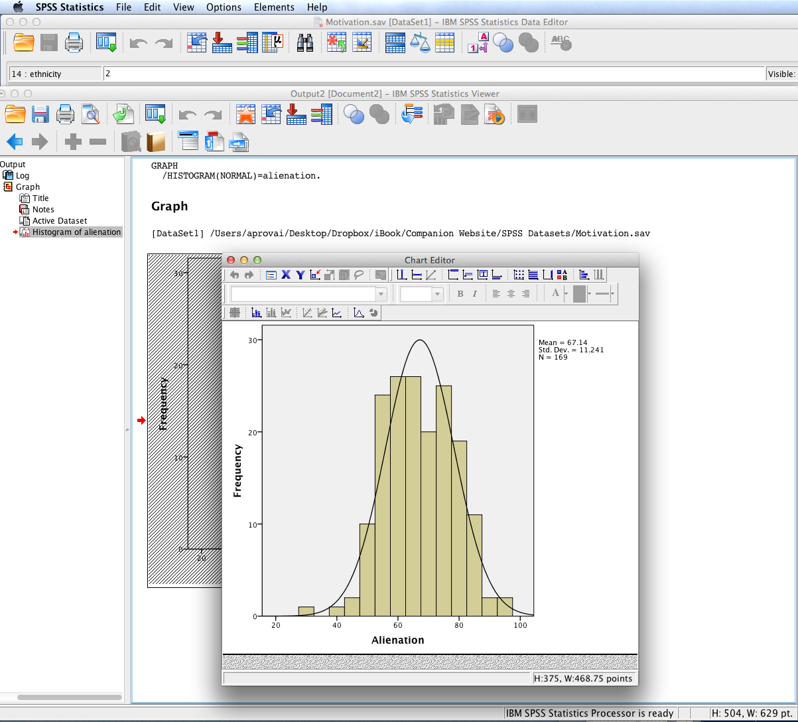
SPSS Output
The Chart Editor opens in a new window with its own Menu bar.

Slide 6

Chart Editor
The Chart Editor opens in a new window with its own
Menu bar. Note that available tools and menu items are based on chart type. Items are greyed out if the corresponding options are not available for the current chart type.

Slide 7
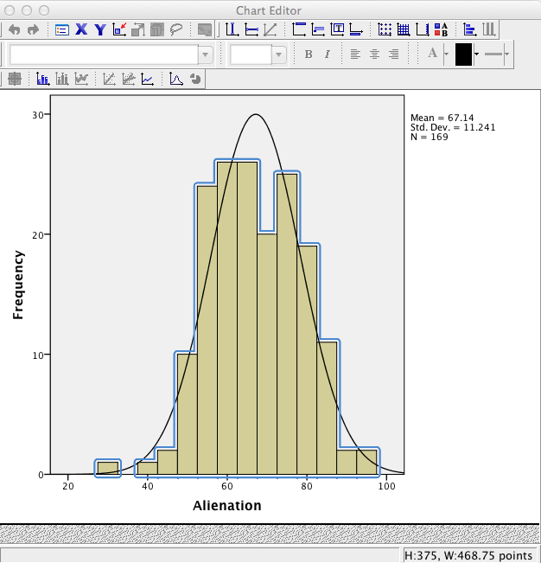
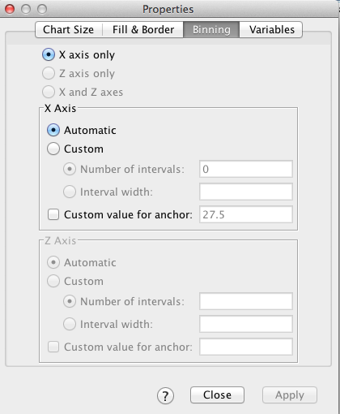
SPSS Output
Click on any element of the graph to modify it. For example, to modify the color of the bins double click on the bins to highlight them as shown to the left and to display the Properties dialog.

Slide 8
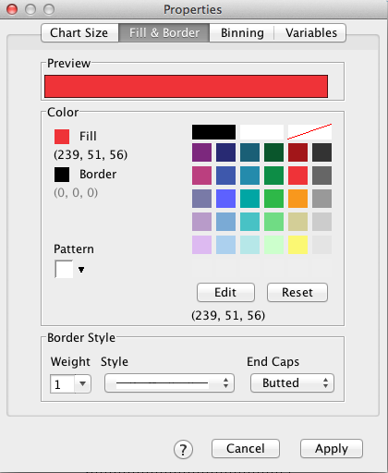
Select the Fill & Border tab and then click the color red on the color palette to change the color of the fill. Then click Apply.

Slide 9
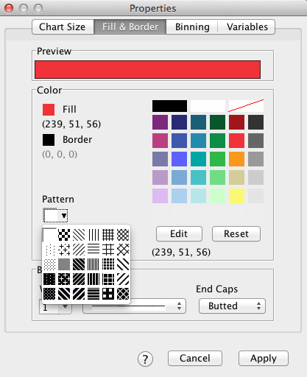
If desired, one can also replace the fill with a pattern instead of a color. Click on the inverted triangle icon to display the pattern palette.

Slide 10
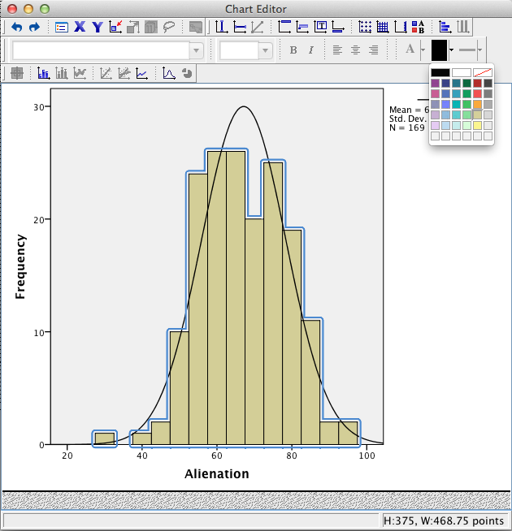
SPSS Output
Select the desired color
by clicking on the appropriate
color swatch, e.g., red.

Slide 11
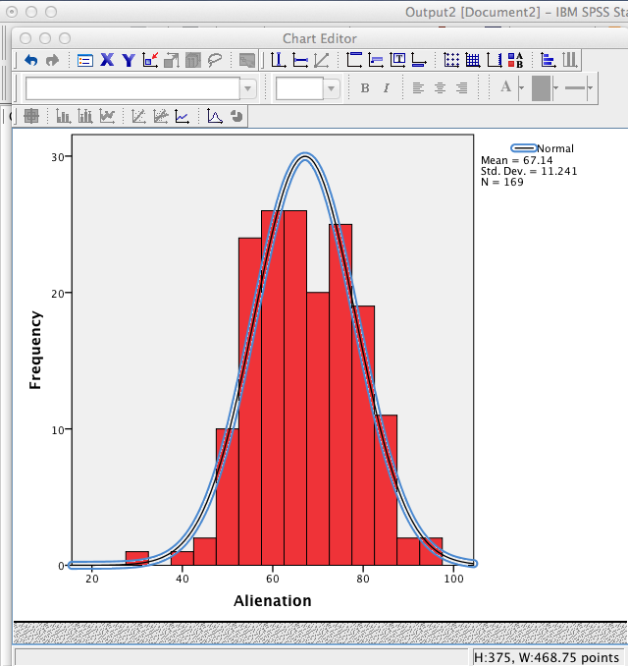
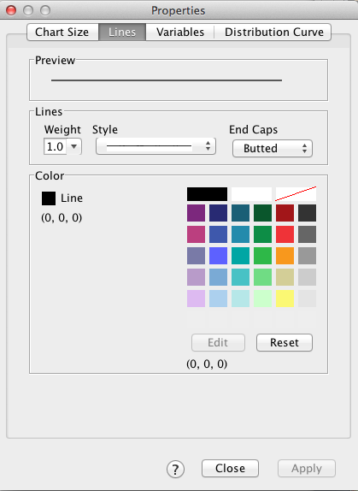
SPSS Output
To modify the normal curve overlay double click it to highlight it as shown to the left and to display the Properties dialog. Several options are available to include changing curve color and line weight.

Slide 12
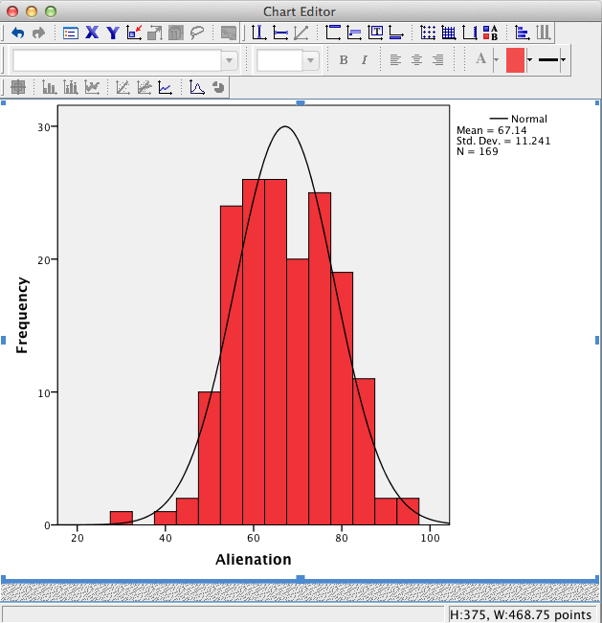
SPSS Output
To hide the legend, click once
on the Hide Legend tool.

Slide 13
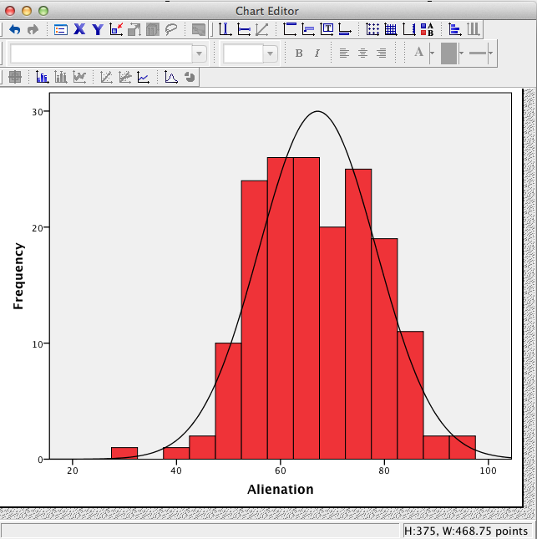
SPSS Output
To remove the normal curve overlay click once on the Hide Distribution Curve icon.

Slide 14
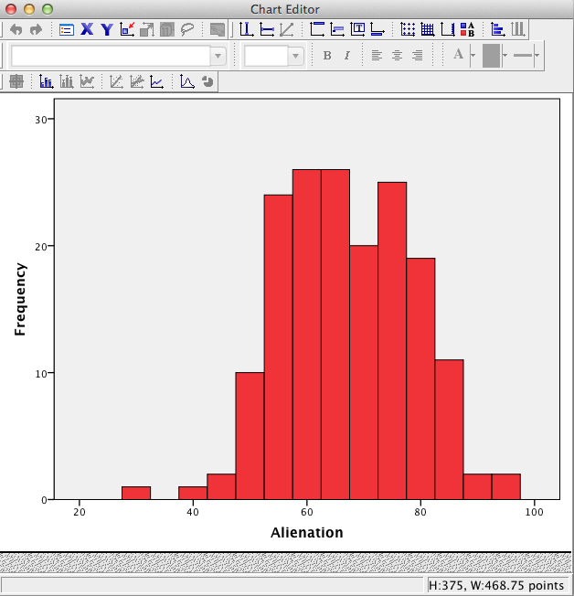
SPSS Output
Additional modifications can be made to the histogram using the various tools on the Chart Editor menu bar.
To copy the chart while the Chart Editor window is open, select Copy Chart from the SPSS Edit menu. You can now paste the histogram in a word processing document and create a figure by adding a caption.
To close the Chart Editor and save changes to the SPSS output window, click the close window icon.

Slide 15
End of Presentation

